Slide 1
CI/CD with Powershell
David Koenig
www.matrix42.com
www.crankdesk.wordpress.com
@davidkoenig09
Notes:
Introduction

Slide 2


The evolution of Powershell development
R
elease
B
uild
T
estautomation
M
odule creation
V
isual Studio for Powershell

Slide 3

isual Studio for Powershell
V
You ask why you are here?
You think Powershell is easy?

Slide 4

isual Studio for Powershell
V
WHAT IS...
Is it really simple?
Thousands lines of Powershell Code
Modules with Dependencies
Interaction with .NET
Different Powershell Versions
Working with more than 1 person
Change in function A will cause exception in function B
IF THE MATRIX IS JUST A POWERSHELL SCRIPT?

Slide 5

isual Studio for Powershell
V
For a Powershell (Script, Module) Project you need…
Automated versioning
Control over your changes
Running regular tests
Signing
Possibly publishing tools
We need Guns.
Lot of guns!

Slide 6


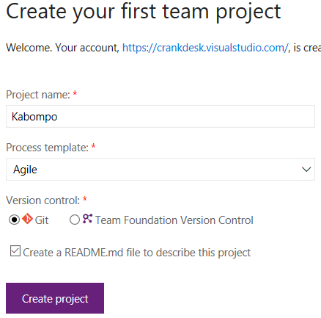
isual Studio for Powershell
V
Sync VSO/VS
Create a GIT / TFVC based Repository
Why GIT
Checkin of files in Offline Mode
A Gatekeeper can acknowledge code before checkin
Github let you design open source projects
Knock, Knock, Developer!

Slide 7
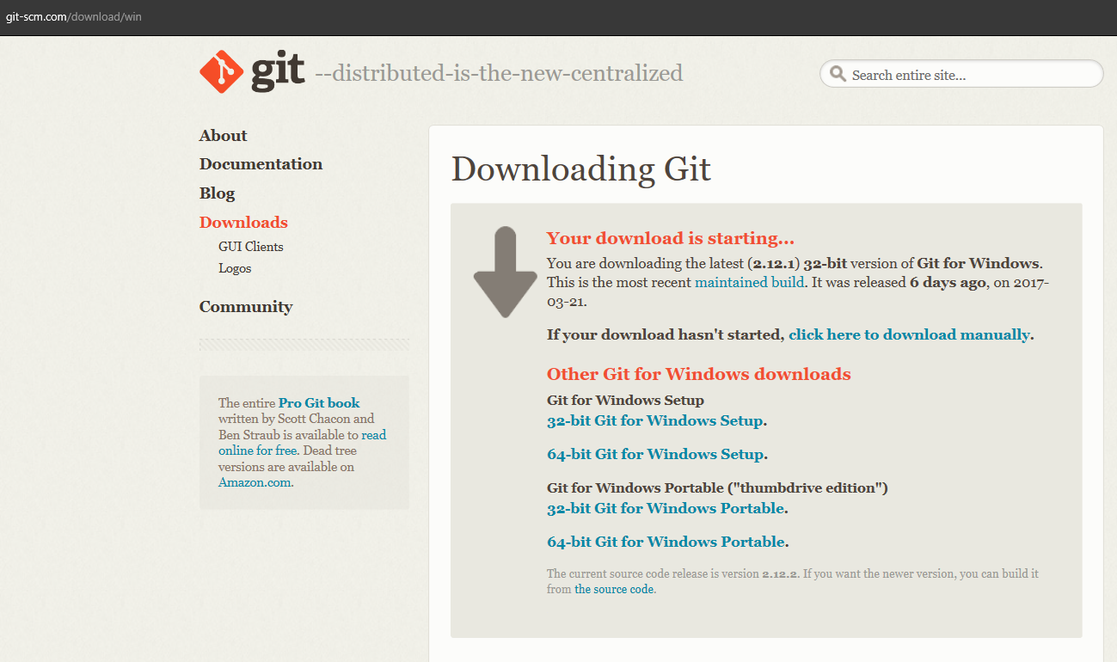
isual Studio for Powershell
V

Slide 8
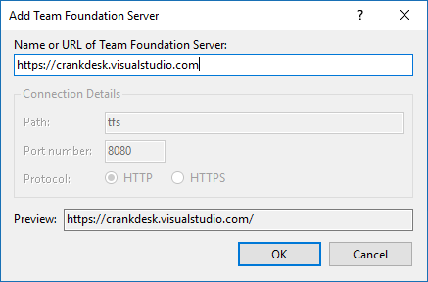
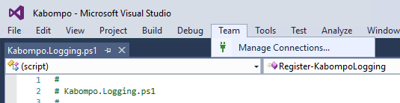
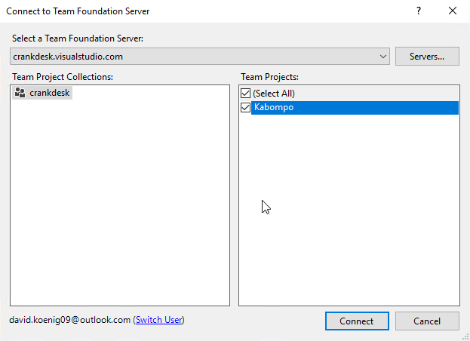
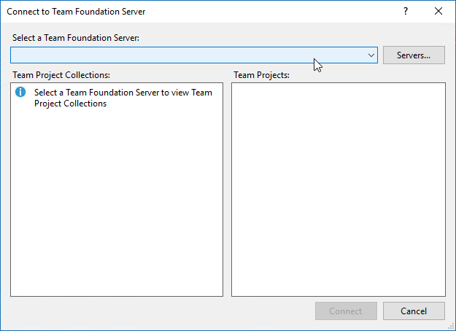
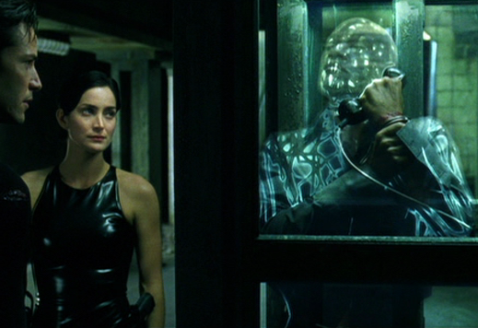
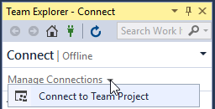
isual Studio for Powershell
V
Connect
Connect to your VSO Online Repository
4
1
3
5
2
We‘ll see us on the other side

Slide 9
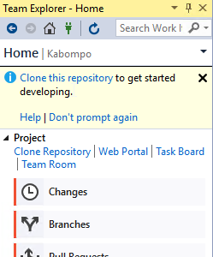
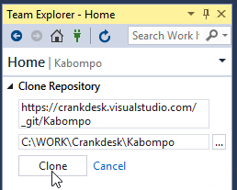

isual Studio for Powershell
V
Clone
Clone the repository to a local folder
1
2
3
You are looking good

Slide 10
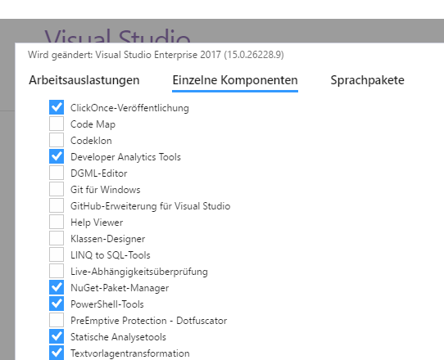
odule creation
M
Create your new project
Prerequsites
Install Powershell Extensions for Visual Studio (Tools -> Extensions and Updates)
TWIA PS -> Daniël te Winkel
PS Tools for VS -> Adam Driscoll
Powershell tools from Visual Studio Installer 2017

Slide 11
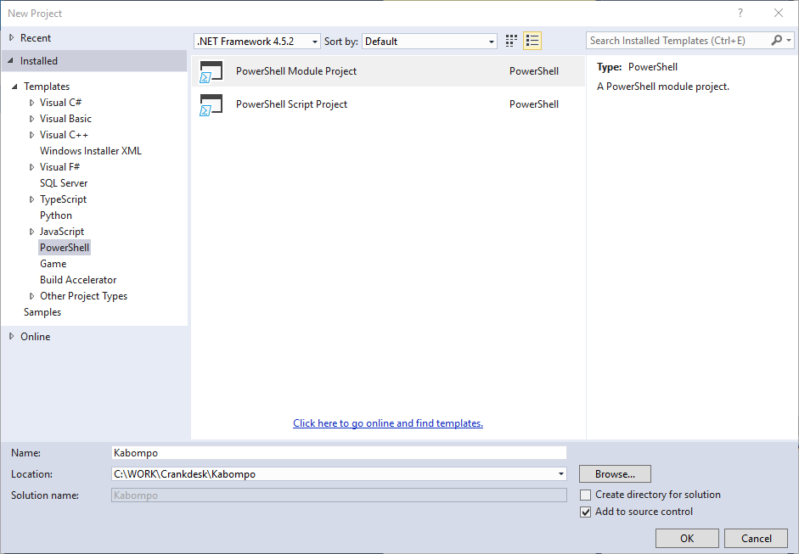
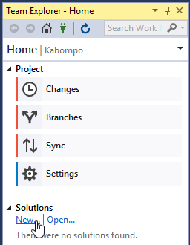
odule creation
M
Create your new project
Create a new Powershell solution
2
1

Slide 12
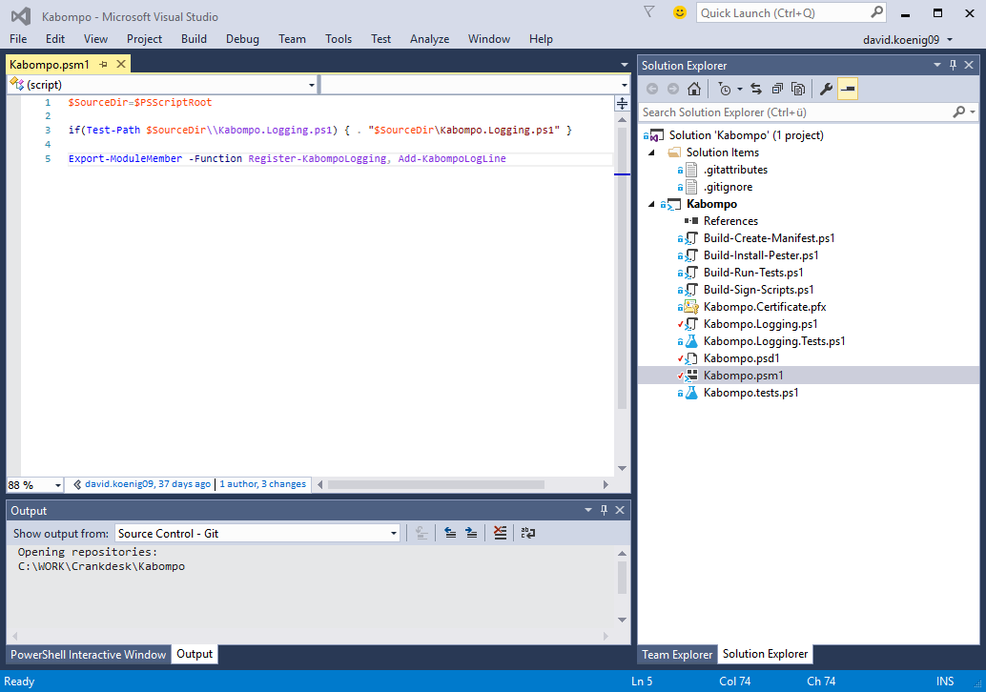
odule creation
M
Add your script logic
Load script files
2
1
Add your script logic
Make functions available
3

Slide 13
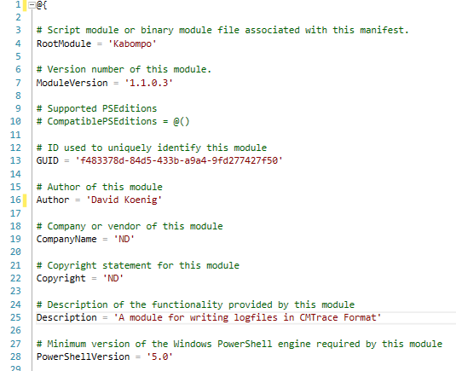
odule creation
M
Create your manifest
Give your baby
a name
1
Add a version
2
Define GUID
3
Set other Meta Info
4
Define minimum version
5

Slide 14
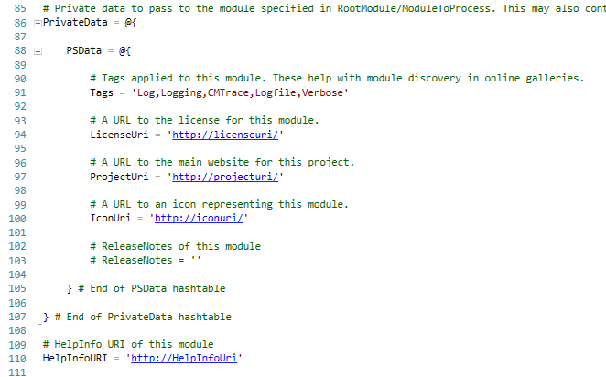
odule creation
M
Create your manifest
Do not export
functions in
manifest
1
FunctionsToExport = '*'
Configure Gallery information
(Powershell 5.0)
2

Slide 15
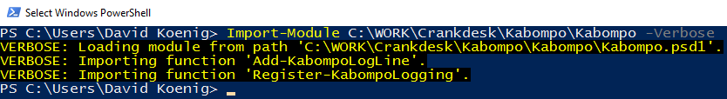

odule creation
M
Ready to rock

Slide 16

estautomation
T
Start with why
Everytime you change something in your code, you have to be sure that the rest of your code is working.
Be careful with Unit Tests. A Unit test will not improve the quality of your code.
A Unit Test make sure that everything is working as you specified in the test.
Causality. Action and reaction.

Slide 17
estautomation
T
How to use Pester
Unit Tests are written in Pester, a Unit Test Framework available in Windows 10.
In a Unit-Test you describe a function/CmdLet and you check the result against a specific value.
Describe {
If {
{ Do-Something } | Should Be $SomethingISpecifiedBefore
}
}
Make something here
Check result here

Slide 18
estautomation
T
Unit Test are independant
In a later step we want to run Unit Tests within the build process on a server which is hosted in the cloud
There are administrative permissions, no backend systems, no special modules available
With „mocking“ you can replace „calls“ that are used in a CmdLet by your own object
Describe {
If {
Mock New-Item $MyMockItem
{ Do-Something } | Should Be $SomethingISpecifiedBefore
}
}
Replace the result of the call of „New-Item“ in „Do-Something“ CmdLet by custom variable

Slide 19
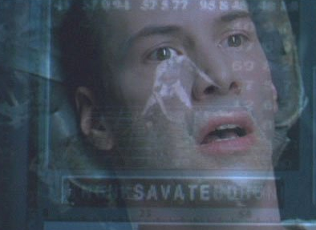
T
estautomation
Thats it.
I know Pester

Slide 20
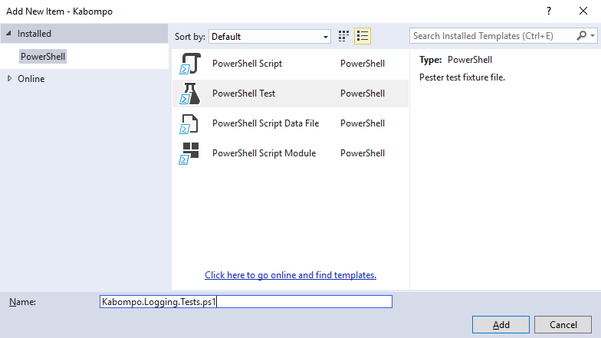
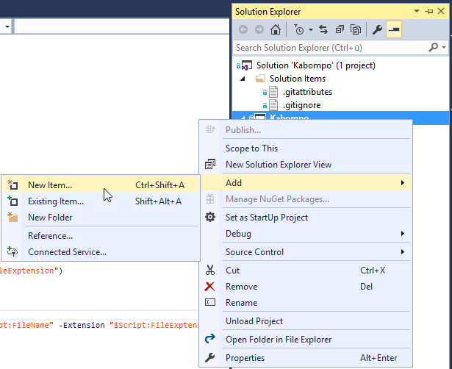
estautomation
T
Create a test in VS
Good news: Visual Studio Powershell extensions are supporting Pester nativly
2
1

Slide 21
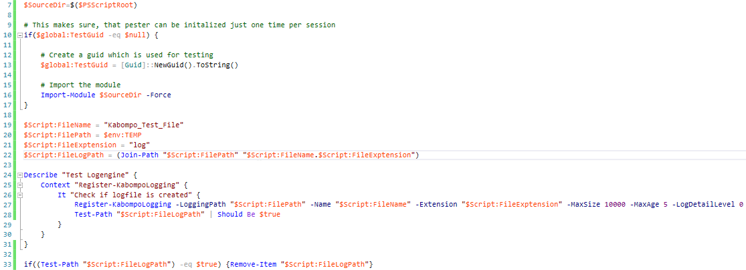
T
estautomation
The script file
Preperation
The first Test
Clean-Up

Slide 22
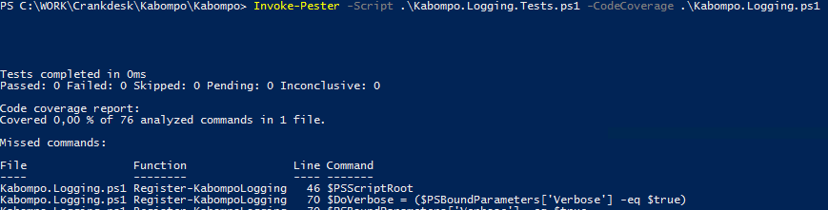
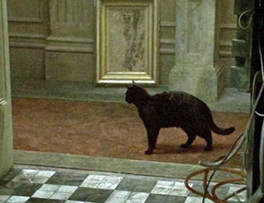
T
estautomation
Testing during develoment
Run Test and measure Code coverage
Invoke-Pester -Script „Kabompo.Tests.ps1" -CodeCoverage "Kabompo.ps1"
Deja vu‘s

Slide 23
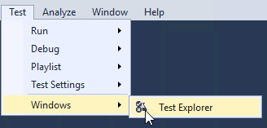
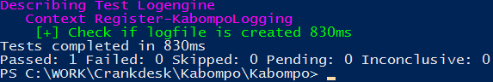
estautomation
T
Run Test regulary
Out of Visual Studio
Start debugging in Visual Studio for *.Tests.ps1 file
Run tests in VS Test Explorer
Powershell Console
Run „<WorkingDir>\Invoke-Pester“

Slide 24
estautomation
T
When i need a backend
You cannot mock calls against an DLL function
$ChosenOne = New-Object System.Matrix.Outside.Operator.Call $Neo, $Trinity
$Wisdom = $ChosenOne.Visit($Oracle)
Devide your Powershell scripts into code you want to test (and publish in the module) and backend code
Public CmdLets
MyMod.ps1
Helper
MyMod.Helper.ps1
DLL
System.Matrix.DLL
Export-ModuleMember
Test
MyMod.Tests.ps1
> 80% Coverage
Backend code

Slide 25
estautomation
T
When i need a backend
For a backend based (DLL-Wrapper-Module) i recommend to write Integration-Tests instead of /additional to Unit Tests
Make the backend system available to the build server (Azure, OnPremise)
In case of integration tests do not „mock“ objects

Slide 26
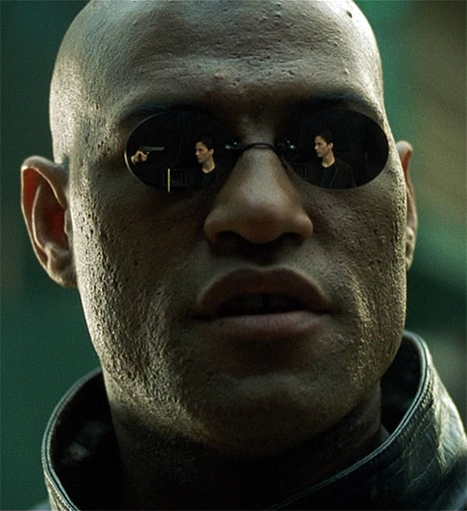

estautomation
T
Effort
Which project needs automated tests?
Calculate the same time for writing good tests as you need for writing the code itself
It‘s your job to find the magic break even
My 1st tip: Do it at the start of your project
My 2nd tip: If you need the script longer than 1 week, do it in every case
Effort
Using Pester
There is a difference between knowing the path and walking the path
Testing everything manual
Project size

Slide 27
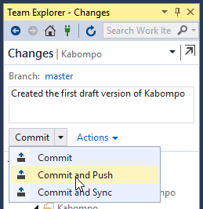
uild
B
Make code available to your team
If you reached this step you can
Work in teams
Compare versions in VS
Work with branches
Merge changes
Associate changesets with work items
...
Commit your
Module to VSO
1

Slide 28
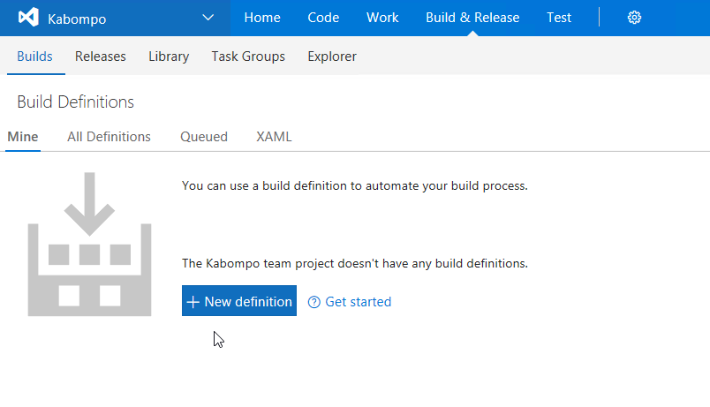
B
uild
Create your build on VSO
1
2
3

Slide 29
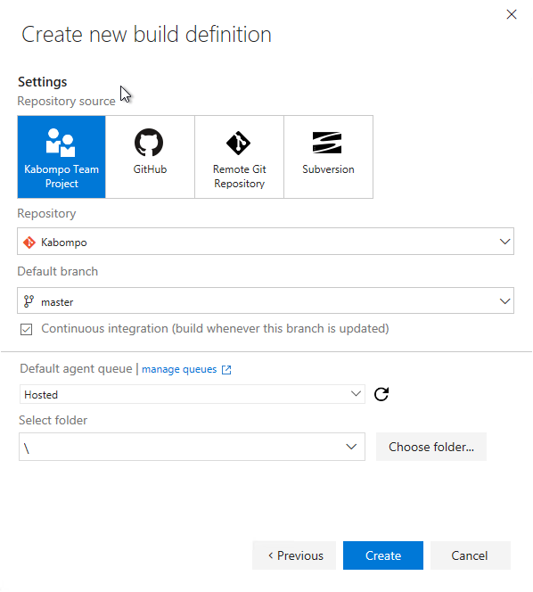
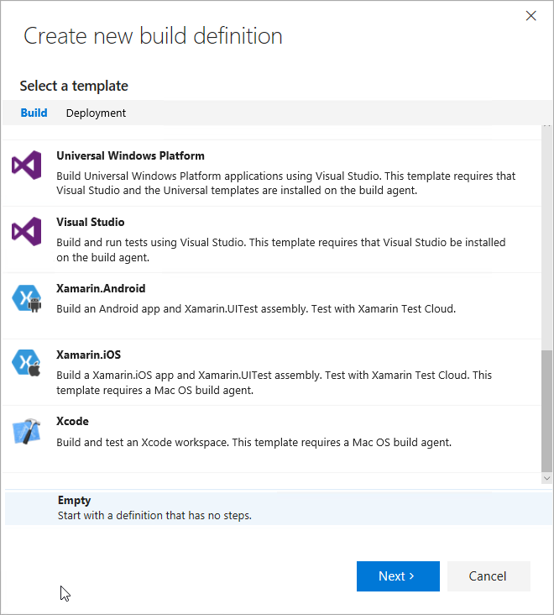
uild
B
Create your build on VSO
Hosted
Microsoft build agent
Installing of 3rd party apps is „tricky“
All other (Default)
Your own OnPremise Agent
Can be executed on every windows system (also Azure VM)
1
2
3

Slide 30
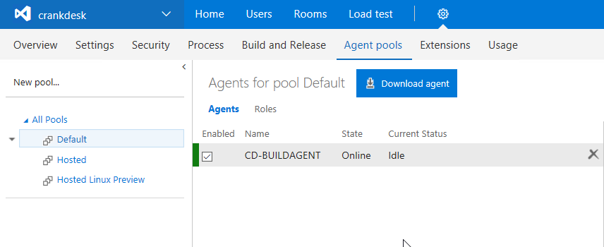
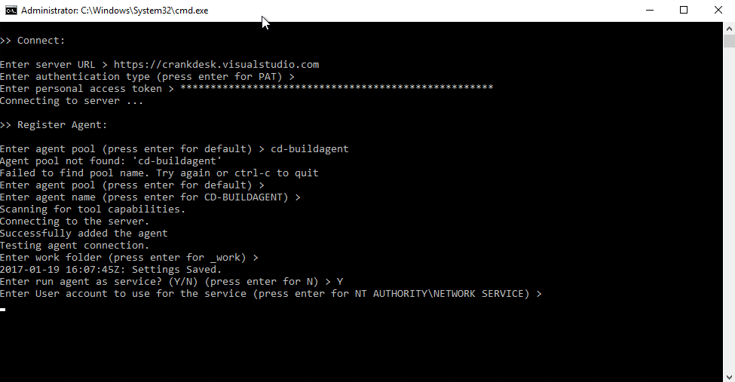
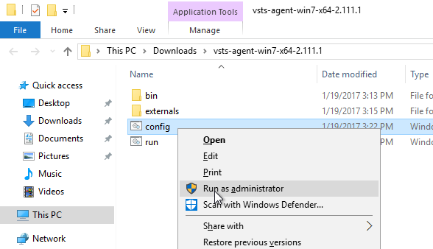
uild
B
Install build agent
1
3
2

Slide 31
uild
B
Design your „Build architecture“
Project Evolution
Build the manifest
Install Pester (and other prereq.)
Run Pester tests
Sign your scripts
Twitter: @davidkoenig09 | Skype: kingdave2nd | Mail: david.koenig@matrix42.com | Blog: https://crankdesk.wordpress.com

Slide 32
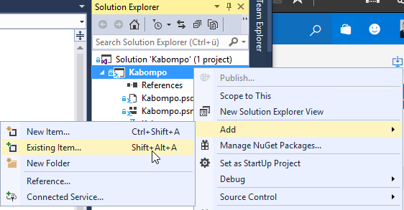
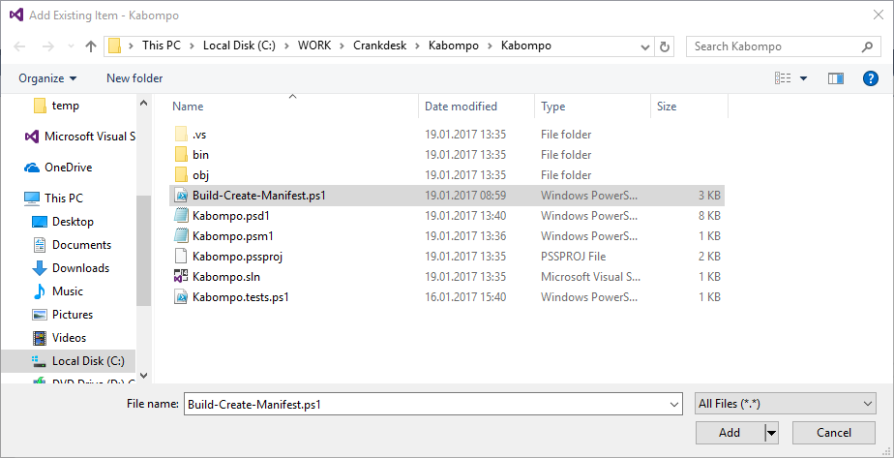
uild
B
Add manifest creation script
Download Powershell Build Evolution Package from crankdesk.wordpress.com
Import „Build-Create-Manifest.ps1“ to your project
a
1
b

Slide 33
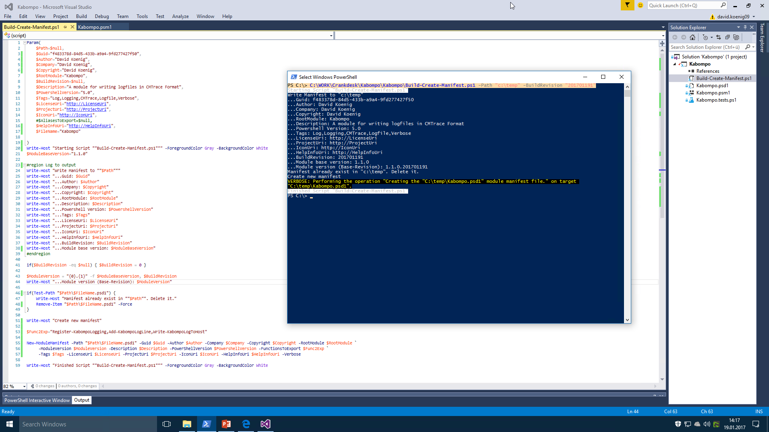
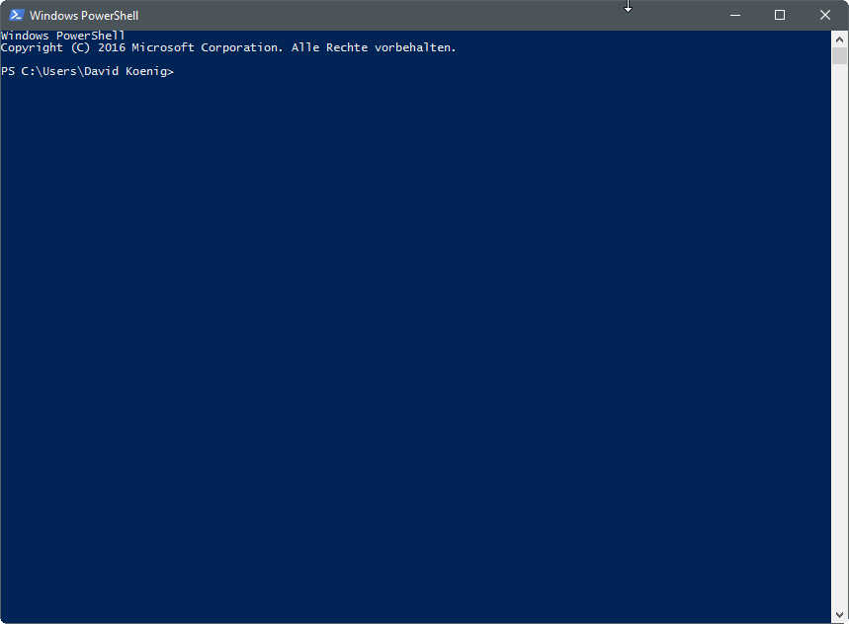
uild
B
Automate manifest creation
Parameter Input
Configure base version
Prerequisite check
Build manifest file

Slide 34
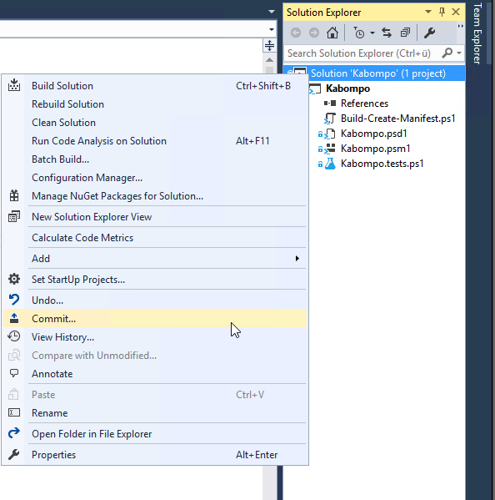
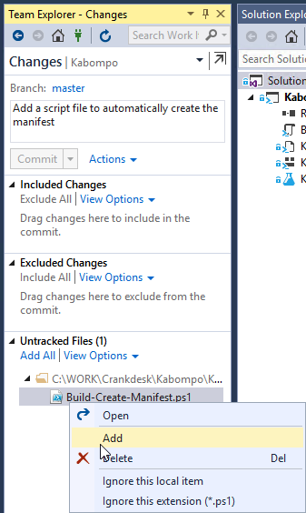
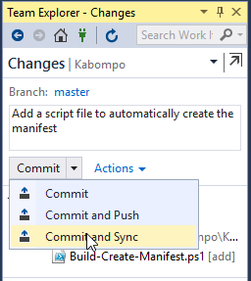
uild
B
Checkin manifest file
2
4
3

Slide 35
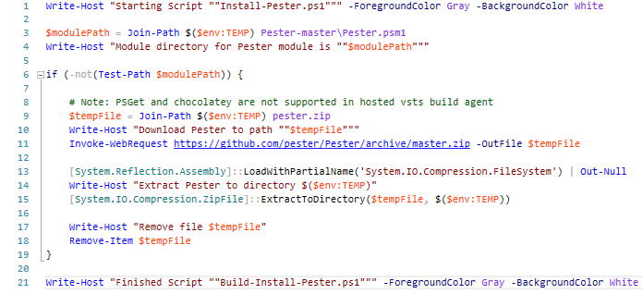
uild
B
Install Pester on build server
Just needed on Hosted Build-Server
If your own build agent is based on Windows 10 or Windows Server 2016 Pester is available per default
Project Evolution
Build the manifest
Install Pester (and other prereq.)
Run Pester tests
Sign your scripts
Download
Uncompress
Cleanup
1
Add script to VS
2
Commit
3
Add script to Git
4
Sync to repo
Twitter: @davidkoenig09 | Skype: kingdave2nd | Mail: david.koenig@matrix42.com | Blog: https://crankdesk.wordpress.com

Slide 36
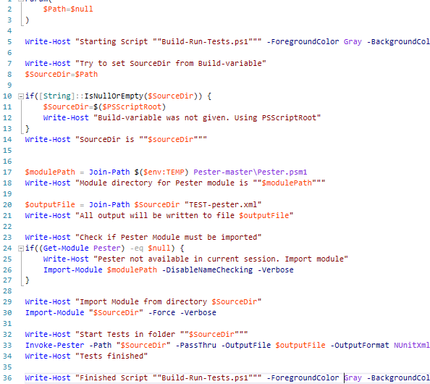
uild
B
Run your tests against your module
Run the test and write a VSO compatible test result file (NUnitXml)
Project Evolution
Build the manifest
Install Pester (and other prereq.)
Run Pester tests
Sign your scripts
Set work dir with input path
Init Pester
1
Import module you want to test
2
3
4
Start test and write output file

Slide 37
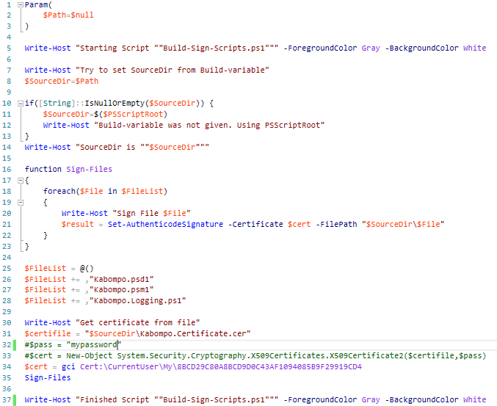
uild
B
Sign script
Signing makes sure that scripts are not changed
Project Evolution
Build the manifest
Install Pester (and other prereq.)
Run Pester tests
Sign your scripts
Set work dir with input path
Sign file
1
Define files that should be tested
2
Import certificate from file or certificate store
3
4

Slide 38
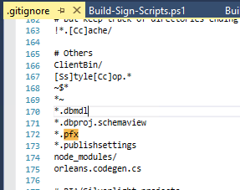
uild
B
Sign script
Add your certificate to the solution (inclusive private key)
Remove PFX exclusion from gitignore
Chekin your certificate
Project Evolution
Build the manifest
Install Pester (and other prereq.)
Run Pester tests
Sign your scripts
Twitter: @davidkoenig09 | Skype: kingdave2nd | Mail: david.koenig@matrix42.com | Blog: https://crankdesk.wordpress.com

Slide 39
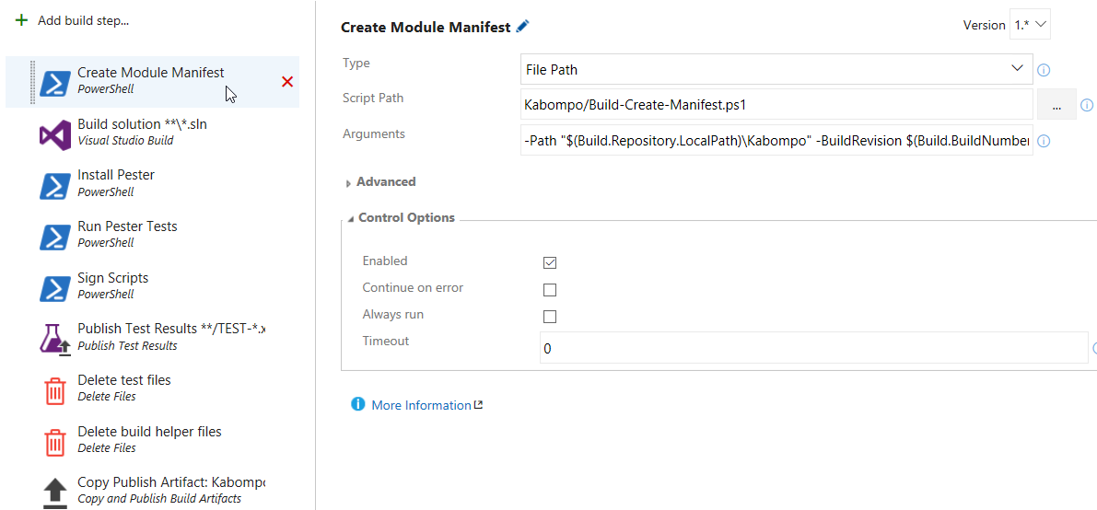
uild
B
Lets configure VSO - Manifest
Project Evolution
Build the manifest
Install Pester (and other prereq.)
Run Pester tests
Sign your scripts
-Path "$(Build.Repository.LocalPath)\Kabompo" -BuildRevision $(Build.BuildNumber)
Twitter: @davidkoenig09 | Skype: kingdave2nd | Mail: david.koenig@matrix42.com | Blog: https://crankdesk.wordpress.com

Slide 40
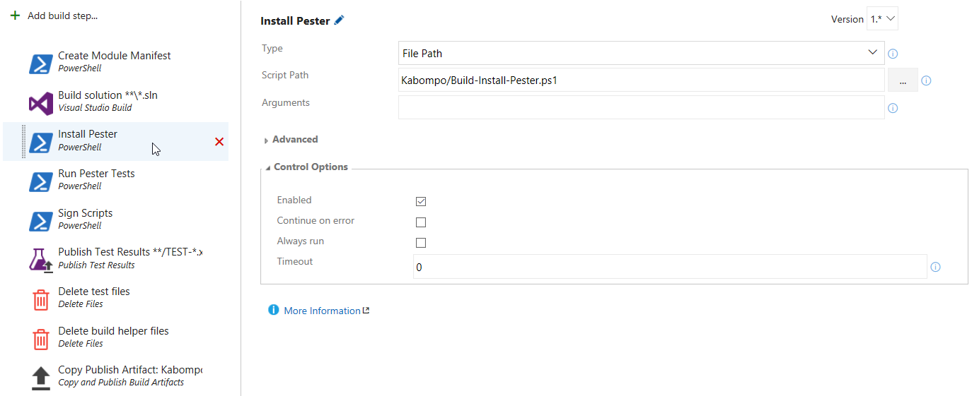
uild
B
Lets configure VSO – Pester
Project Evolution
Build the manifest
Install Pester (and other prereq.)
Run Pester tests
Sign your scripts

Slide 41
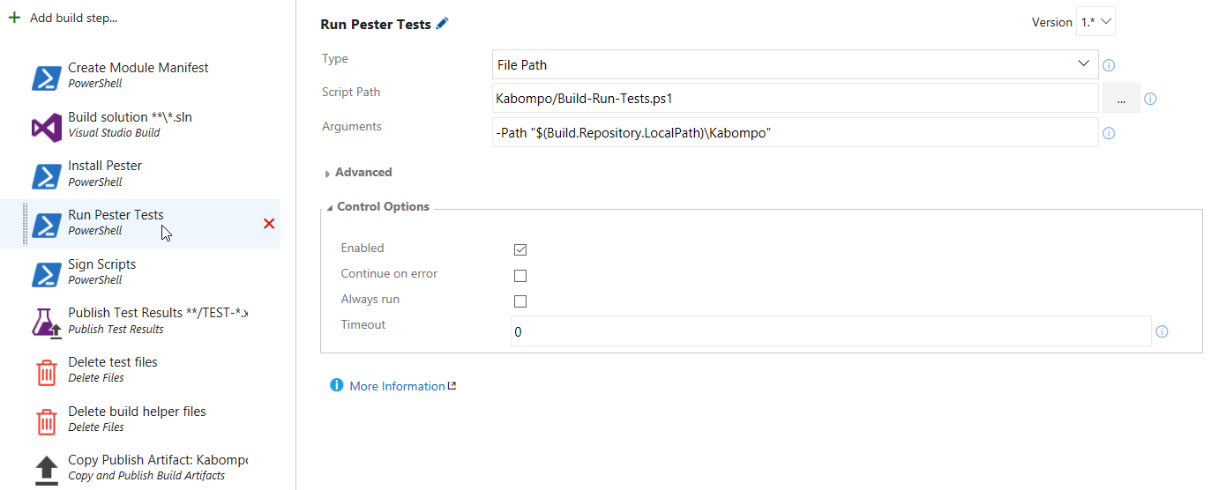
uild
B
Lets configure VSO - Tests
Project Evolution
Build the manifest
Install Pester (and other prereq.)
Run Pester tests
Sign your scripts

Slide 42
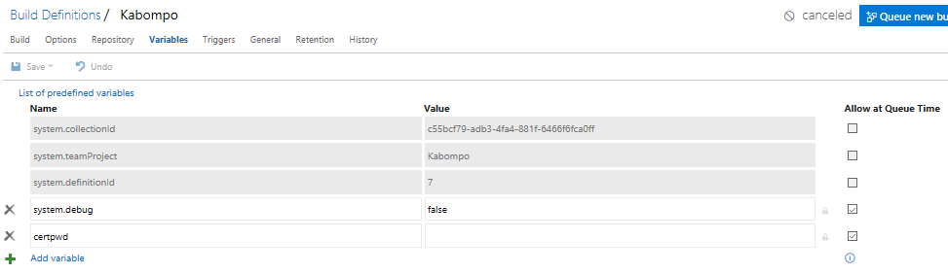
uild
B
Lets configure VSO - Sign
Project Evolution
Build the manifest
Install Pester (and other prereq.)
Run Pester tests
Sign your scripts
Update: You can also sign your scripts during release.
Release variables can be encrypted there.
Twitter: @davidkoenig09 | Skype: kingdave2nd | Mail: david.koenig@matrix42.com | Blog: https://crankdesk.wordpress.com

Slide 43
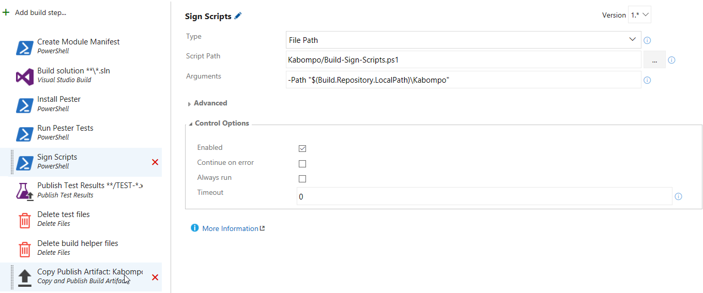
B
uild
Lets configure VSO - Sign
Project Evolution
Build the manifest
Install Pester (and other prereq.)
Run Pester tests
Sign your scripts

Slide 44
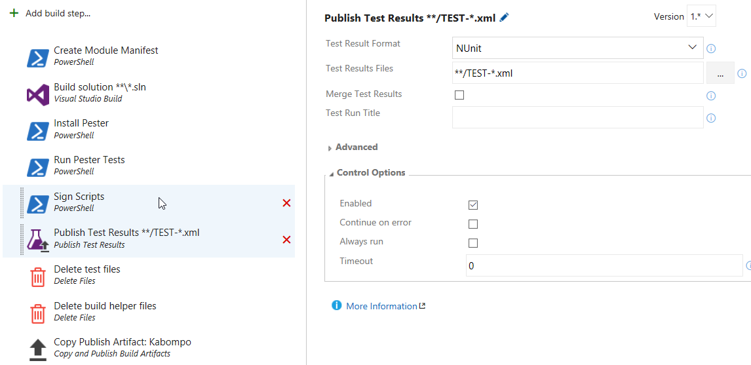
uild
B
Lets configure VSO – Publish tests
Project Evolution
Build the manifest
Install Pester (and other prereq.)
Run Pester tests
Sign your scripts

Slide 45


uild
B
Lets configure VSO – Delete build files
Project Evolution
Build the manifest
Install Pester (and other prereq.)
Run Pester tests
Sign your scripts
Build-Create-Manifest.ps1
Build-Install-Pester.ps1
Build-Run-Tests.ps1
Build-Sign-Scripts.ps1

Slide 46

uild
B
Lets configure VSO - Artifacts
Project Evolution
Build the manifest
Install Pester (and other prereq.)
Run Pester tests
Sign your scripts
Everything you want to publish with the module
Everything you need for release
Twitter: @davidkoenig09 | Skype: kingdave2nd | Mail: david.koenig@matrix42.com | Blog: https://crankdesk.wordpress.com

Slide 47


uild
B
Run the build
Project Evolution
Build the manifest
Install Pester (and other prereq.)
Run Pester tests
Sign your scripts
Twitter: @davidkoenig09 | Skype: kingdave2nd | Mail: david.koenig@matrix42.com | Blog: https://crankdesk.wordpress.com

Slide 48

uild
B
Run the build
Project Evolution
Build the manifest
Install Pester (and other prereq.)
Run Pester tests
Sign your scripts
Twitter: @davidkoenig09 | Skype: kingdave2nd | Mail: david.koenig@matrix42.com | Blog: https://crankdesk.wordpress.com

Slide 49


uild
B
Download artifacts
Project Evolution
Build the manifest
Install Pester (and other prereq.)
Run Pester tests
Sign your scripts
Twitter: @davidkoenig09 | Skype: kingdave2nd | Mail: david.koenig@matrix42.com | Blog: https://crankdesk.wordpress.com

Slide 50

uild
B
At least, change one little thing
Project Evolution
Build the manifest
Install Pester (and other prereq.)
Run Pester tests
Sign your scripts
Twitter: @davidkoenig09 | Skype: kingdave2nd | Mail: david.koenig@matrix42.com | Blog: https://crankdesk.wordpress.com

Slide 51

uild
B
You mastered it
Powershell lifecycle
is yours
Twitter: @davidkoenig09 | Skype: kingdave2nd | Mail: david.koenig@matrix42.com | Blog: https://crankdesk.wordpress.com

Slide 52
elease
R
Why Release Management
Release should be done by dedicated people
Product Manager, Release Manager, Application Owner
A release should create reproducable results
A release could deploy a solution to several environments

Slide 53

elease
R
Releasemanagement in VSO
Environments
Releases definitions
The tasks that should be executed for every environment
1
2
3
4

Slide 54





elease
R
Possible targets

Slide 55















Thanks to our Sponsors!

